Slide 1
Options Presentation

Slide 2
Options Strategies
Call – Right to buy underlying at a specified strike at expiry
Put – Right to sell underlying at a specified strike at expiry
Straddle – Buying both a call and a put of the same strike and same expiry giving one the right to buy or sell the underlying at expiry
Strangle – Buying an out of the money Call and Put with the same expiry
Risk Reversal- Buying an out of the money call and selling an out of the money put of the same expiry date

Slide 3
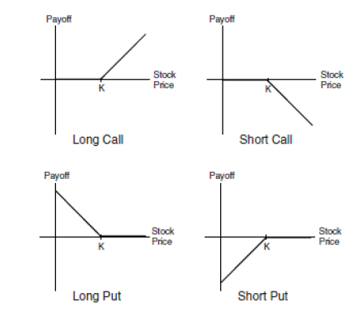
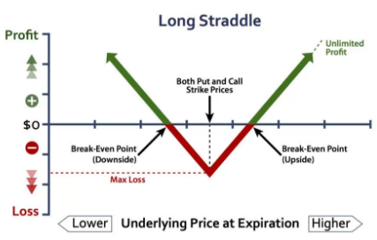
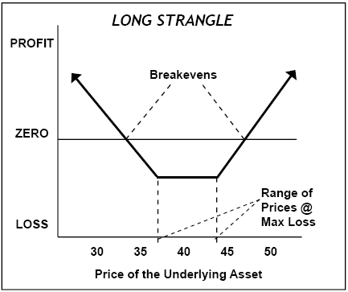
Payout
Payout on a call = Base Notional* (spot-strike)/spot
Payout on a put = Base Notional * (strike-spot)/spot

Slide 4
Greeks: High-level Overview
Delta: your synthetic exposure to the underlying ➡ change in the option’s value with a 1% change in spot
Gamma: second-order derivative of change in option value wrt change in spot 🡪 change in delta with a 1% change in spot
Vega: change in option’s value with a 1% change in implied vol
Theta: change in option’s value with 1 day less to maturity
➡ Option value = Intrinsic value + Time value; where
Intrinsic value is the value of the option if you were to exercise it today
Calls = Max {0, Forward – Strike}
Put = Max {0, Strike – Forward}
Time value = Optionality = Theta
Intrinsic Value
Value
Time Value
Strike

Slide 5
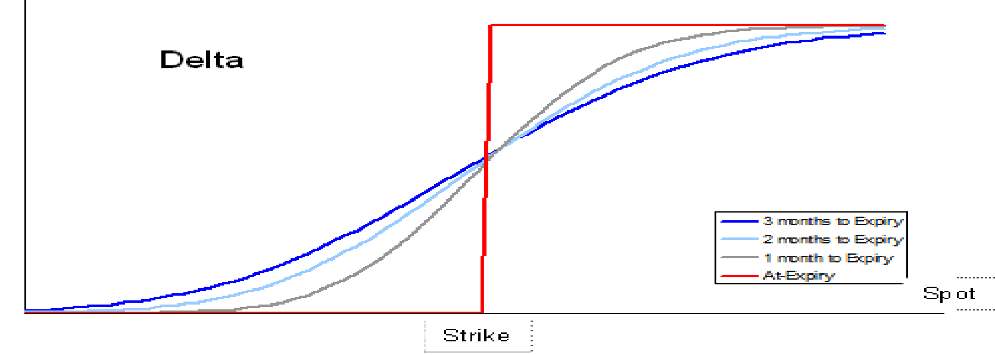
Delta
Definition 1: spot sensitivity of the premium (change in option value for 1% change in spot)
Represents the equivalent position in the underlying that would give the same P&L as the derivative for a small move in spot
If you hold the derivative and take the opposite delta position, you isolate yourself from spot risk for small moves
Expressed as a percentage of the notional amount
Definition 2: (roughly) equivalent to the probability to be in-the-money at expiry
For a vanilla, delta is always between 0% and 100% (for a call) or 0% and -100% (for a put)

Slide 6
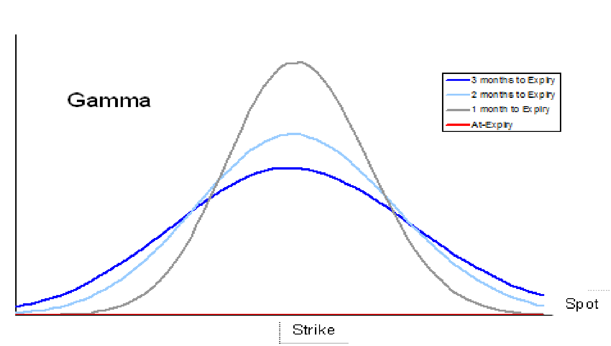
Gamma
Definition: the change of delta relative to a 1% change in spot (2nd derivative of delta)
Key concept: gamma options = short dated; e.g. gamma risk reversal = ca. 1-week risk reversal
As the time to expiry decreases, the ATM gamma increases sharply

Slide 7
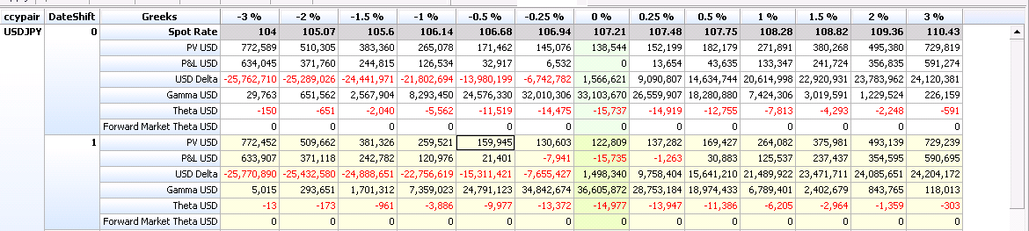
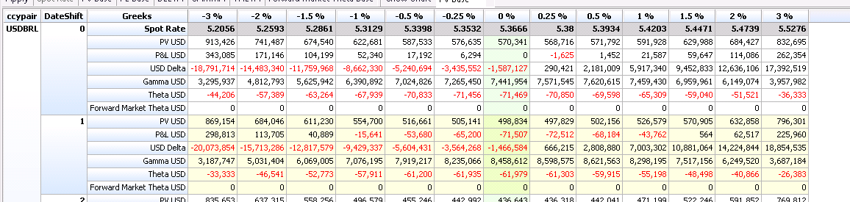
Gamma Example

Slide 8
Factors in Option Pricing
Main factors in Black Scholes model that determine option pricing:
Time to expiration – the more time left until expiry the more value the option has
Implied Volatility – the higher the implied volatility there is, the more value the option has
Strike – the closer to at the money the strike is the more value the option has

Slide 9
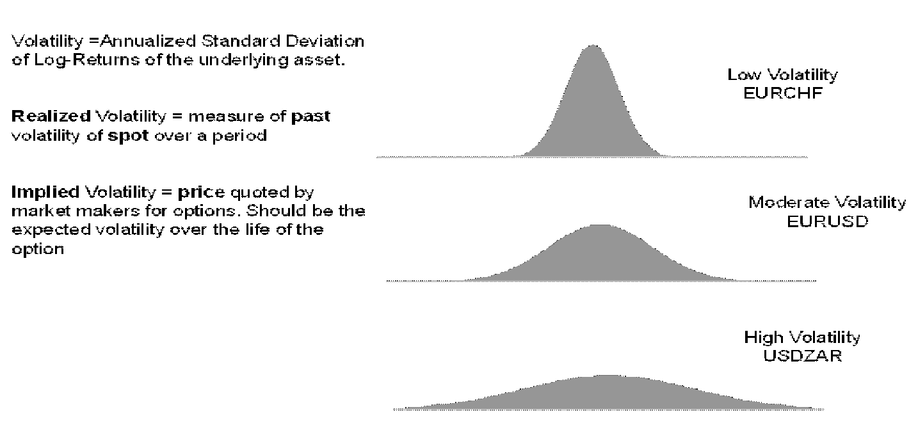
What is Volatility?
Realized Volatility = measure of past volatility of spot over a period
Implied Volatility = price quoted for options. It’s roughly the expected volatility over the life of the option within a 1 standard deviation confidence interval.

Slide 10
Who trades Fx Options And why?
Hedge Funds – Often speculators taking view on direction of a currency pair or the implied volatility of a currency pair. An example of a directional trade would be a hedge fund buys a usdjpy put because they want to profit off of usdjpy moving lower without the downside of losing a lot of money if usdjpy goes higher. An example of a play on implied volatility would be a hedge fund selling a straddle on usdjpy because they believe usdjpy vols are too high and believe they will make more on the premium from the option than they will lose from the spot move in usdjpy
Real Money – Speculative or hedge. An example of a hedge would be a health insurance company in Russia buying a usdrub call once covid starts as a hedge against increasing cases. If Russia gets hit hard from Covid, USDRUB will likely move much higher. Their call will help mitigate losses but still with limited loss (premium)
Corporates – Hedge. An example of a hedge for a corporate may be a flower company in Colombia buying a USDCOP put. The company has its manufacturing done in Colombia but sells its flowers in America so it receives USD and pays Colombian pesos. Buying a USD put can help the company reduce its losses to USDCOP going down and having the USD it receives become worth less while the pesos its paying being worth more.

Slide 11
FX Options: Example
One month ago, I paid 100k for 20mio USDJPY USD calls with a 3 month expiration at a 107 strike. USDJPY is now at 108. Should I exercise the call? How did I do on the trade?
Yes, I would choose to buy USDJPY at 107 as it is much lower than where I would have to buy now at 108. The payout would be 20mio* (108-107)/108 = $185,185.2.
I did well on the trade since I only paid 100,000 for the option.

Slide 12
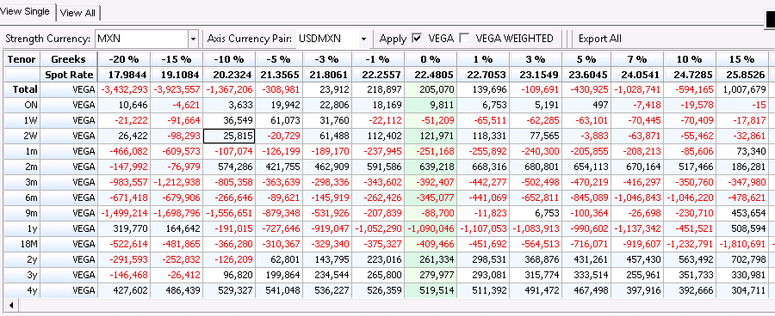
Trading Considerations
Client asks 100mio of a 3 month USDMXN option. What are our main considerations?
Greeks – 5.5mio gamma, 200k vega. How does that fit our overall greeks as well as our bucketing?
Hedge – If I want to hedge some or all of this trade - Where do I think I could get out of the risk or similar risk?

Slide 13
Analyst Responsibilities
Expiries- one of the first and more important responsibilities is executing expiries
Trading deltas – watching the books and helping hedge deltas for the book is great trading experience and helps desk mitigate delta risk
Client trading/Hedging – Once desk and you are comfortable, analysts often get opportunity to show clients prices and hedge in the interdealer broker market.

Slide 14
Shameless Plug

Slide 15
Who trades Options And Why? (A FX Example)
Hedge Funds – Often speculators taking view on direction of a currency pair or the implied volatility of a currency pair. An example of a directional trade would be a hedge fund buys a USDJPY put because they want to profit off of USDJPY moving lower without the downside of losing a lot of money if USDJPY goes higher. An example of a play on implied volatility would be a hedge fund selling a straddle on USDJPY because they believe USDJPY vols are too high and believe they will make more on the premium from the option than they will lose from the spot move in USDJPY.
Notes:
Slippage

Slide 16
Who trades Options And Why?
Real Money – Speculative or hedge. An example of a hedge would be a health insurance company in Russia buying a USDRUB call once covid starts as a hedge against increasing cases. If Russia gets hit hard from Covid, USDRUB will likely move much higher. Their call will help mitigate losses but still with limited loss (premium)
Corporates – Hedge. An example of a hedge for a corporate may be a flower company in Colombia buying a USDCOP put. The company has its manufacturing done in Colombia but sells its flowers in America so it receives USD and pays Colombian pesos. Buying a USD put can help the company reduce its losses to USDCOP going down and having the USD it receives become worth less while the pesos its paying being worth more.

Slide 17
Thank you!

